Slide 1
Sample Marketing Presentation outlines to be discussed in class
content & format-wise

Slide 2
OUTLINE:
Two main reasons why Spotify is successful
*Their user friendly policies
*Their individual-based marketing strategy

Slide 3
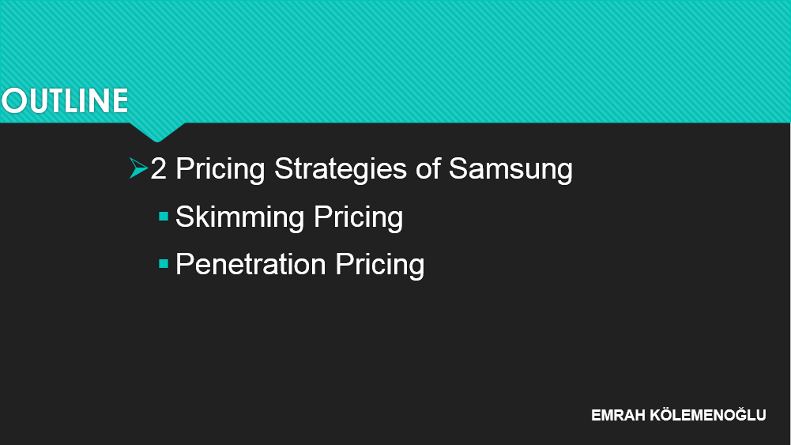
OUTLINE
2 Pricing Strategies of Samsung
Skimming Pricing
Penetration Pricing

Slide 4
OVERVIEW:
Two Main Reasons Why Tesla Will Keep Rising in the Future Market
•Tax Payer Friendly Costs
•Environmentally Correct Products

Slide 5
OVERVIEW:
Two strategies which are employed to increase market share
1.Building a strong brand identity
2.Using innovation

Slide 6
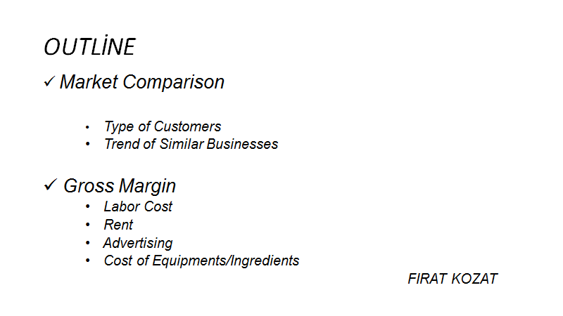
Marketing Presentation Outlines

Slide 7
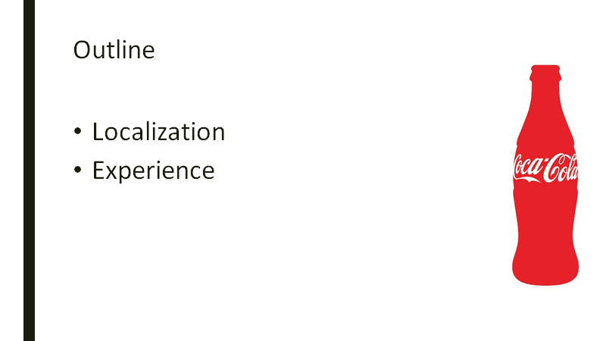

Slide 8
Topic: The success of Steam
1) What is the Steam?
2) Why is the Steam so successful and popular in gaming industry?

Slide 9
OUTLINE:
Topic: Reasons why Steam is successful
1) online supermarket for gamers
2) the fanciest library for gamers

Slide 10
Why Starbucks became popular?
Reasons
History of Starbucks
Place choice
Product quality

Slide 11
OUTLINE:
Topic: Disadvantages of Planned Obsolescence
History of planned obsolescence
Areas that are affected by planned obsolescence
Its effect on consumers’ satisfaction

Slide 12
Topic: History of Bosch
•Birth of Bosch
•Development of Bosch
After-sale service
Preserving customer rights

Slide 13
TOPIC: Why Alibaba is so successful:
1)History
2)Being international
3) Good pricing

Slide 14
OVERVIEW:
Two main reasons for the success of L’Oreal Paris ;
Wide range of products and their managements
Effective promotion and advertising

Slide 15
AGENDA:
Two main reasons why Danone is successful
Variety of products
Attractiveness of advertisements

